Slide 1
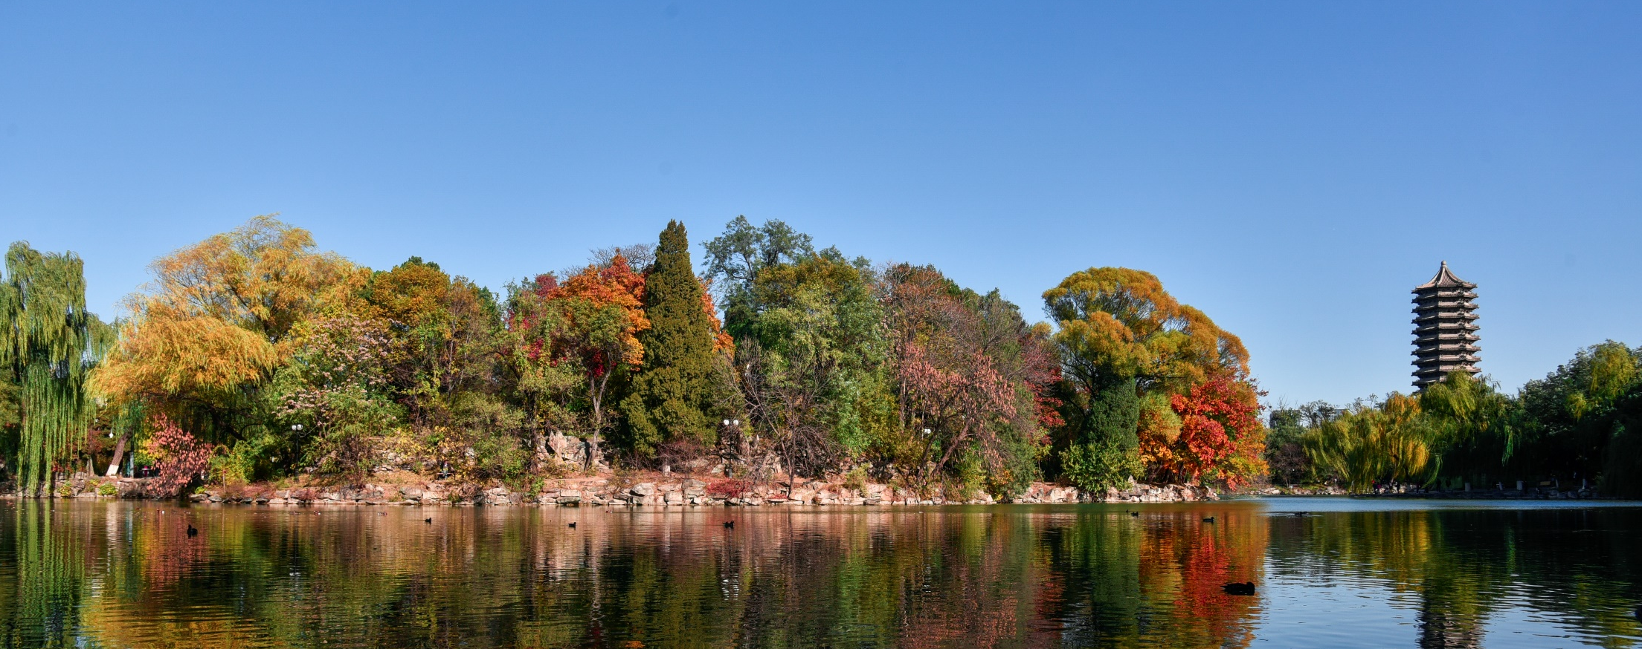

Computer Applications to Behavioral Sciences
Functions
何吉波，博士
清华大学用户体验学科负责人
优视眼动科技公司创始人
http://www.usee.tech

Slide 2
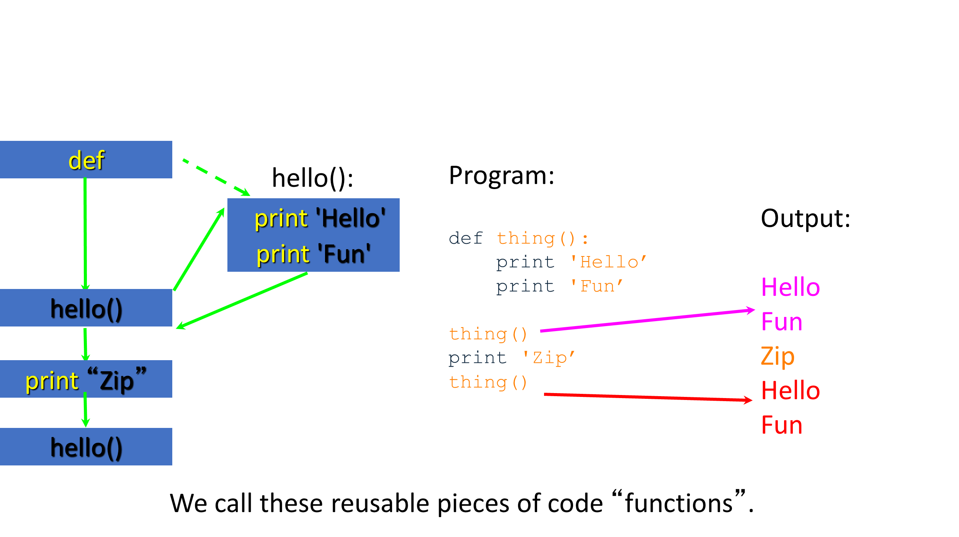
Stored (and reused) Steps

Slide 3
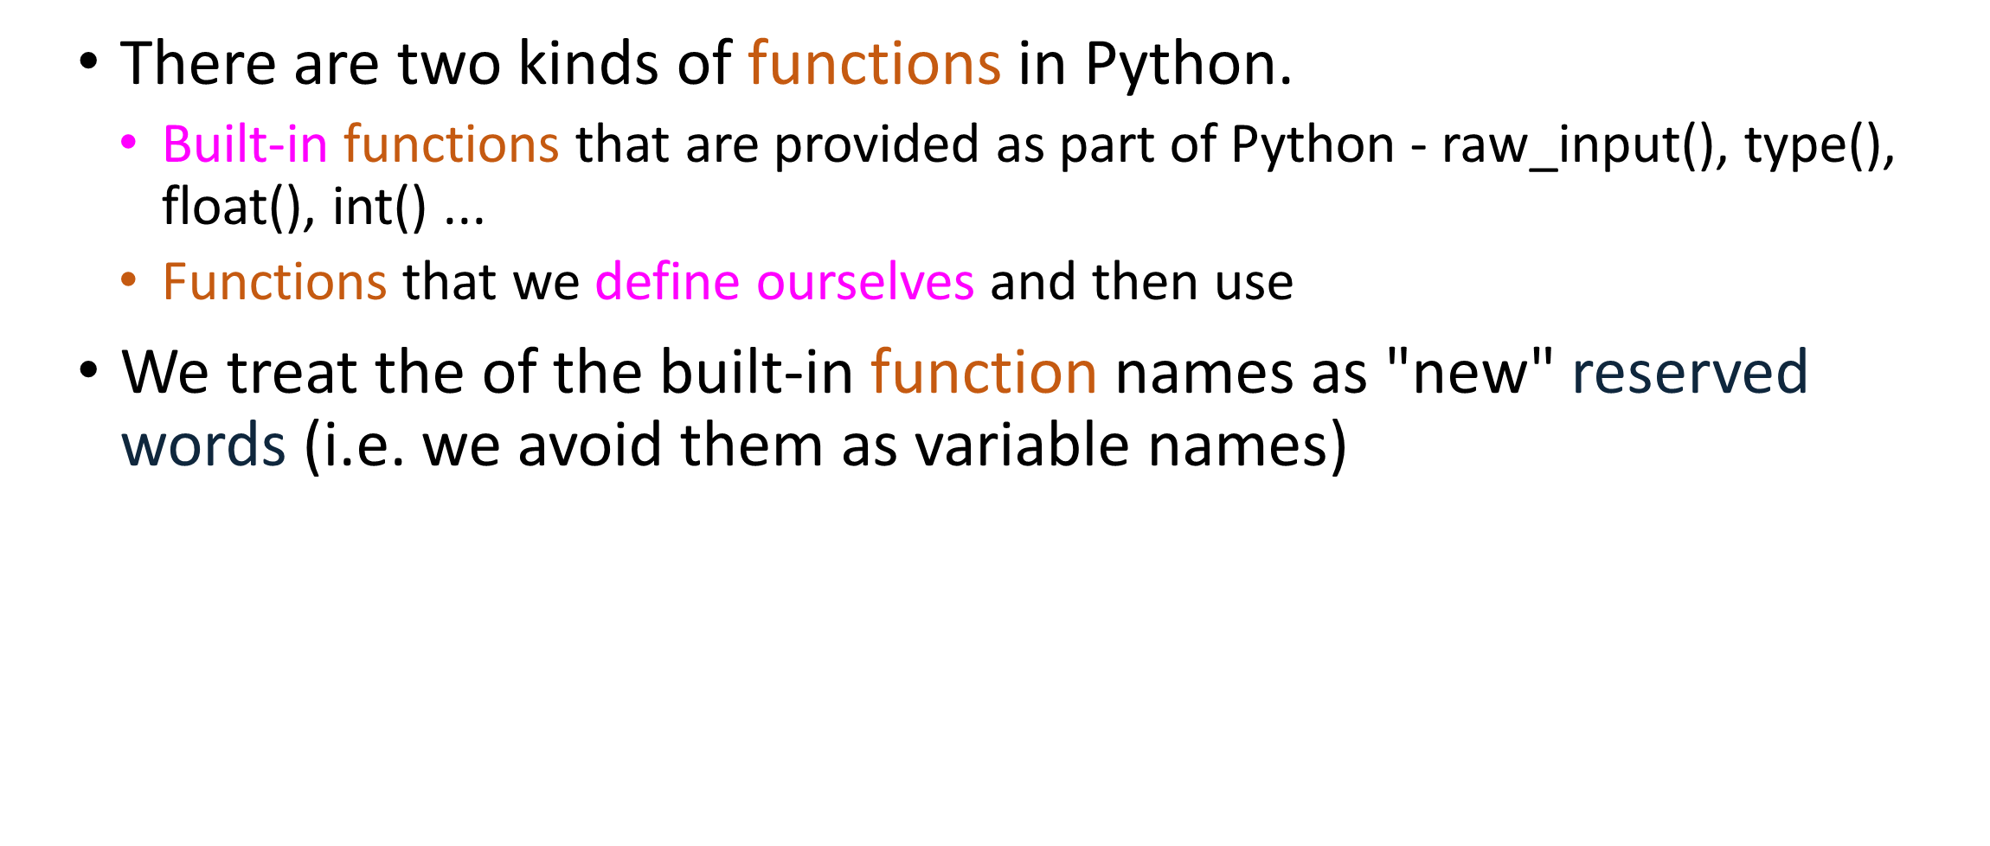
Python Functions

Slide 4
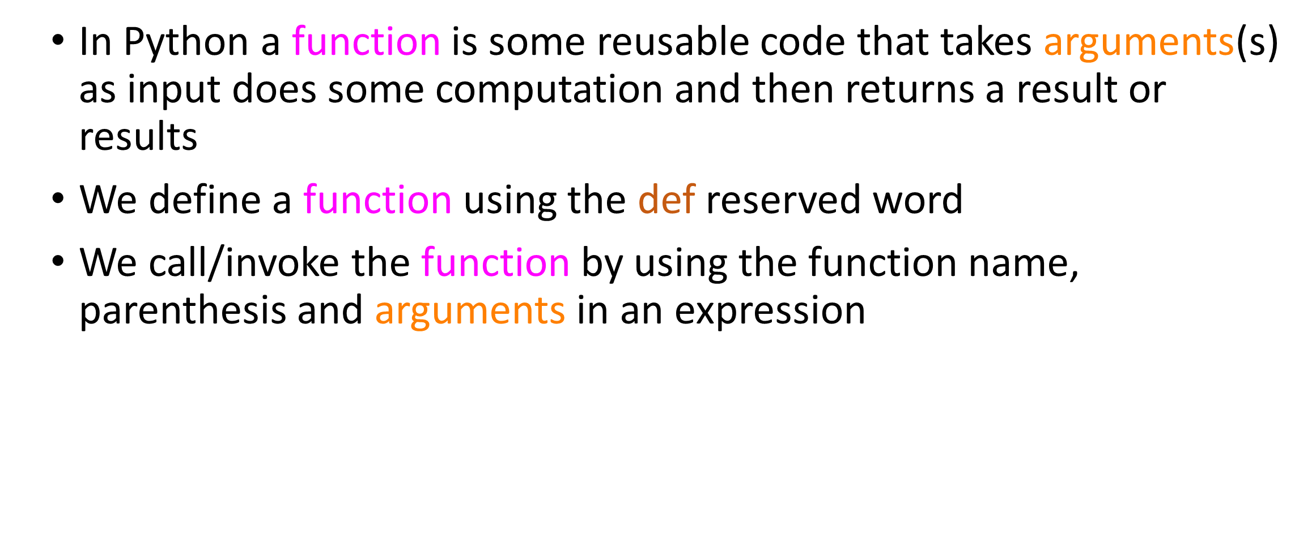
Function Definition

Slide 5
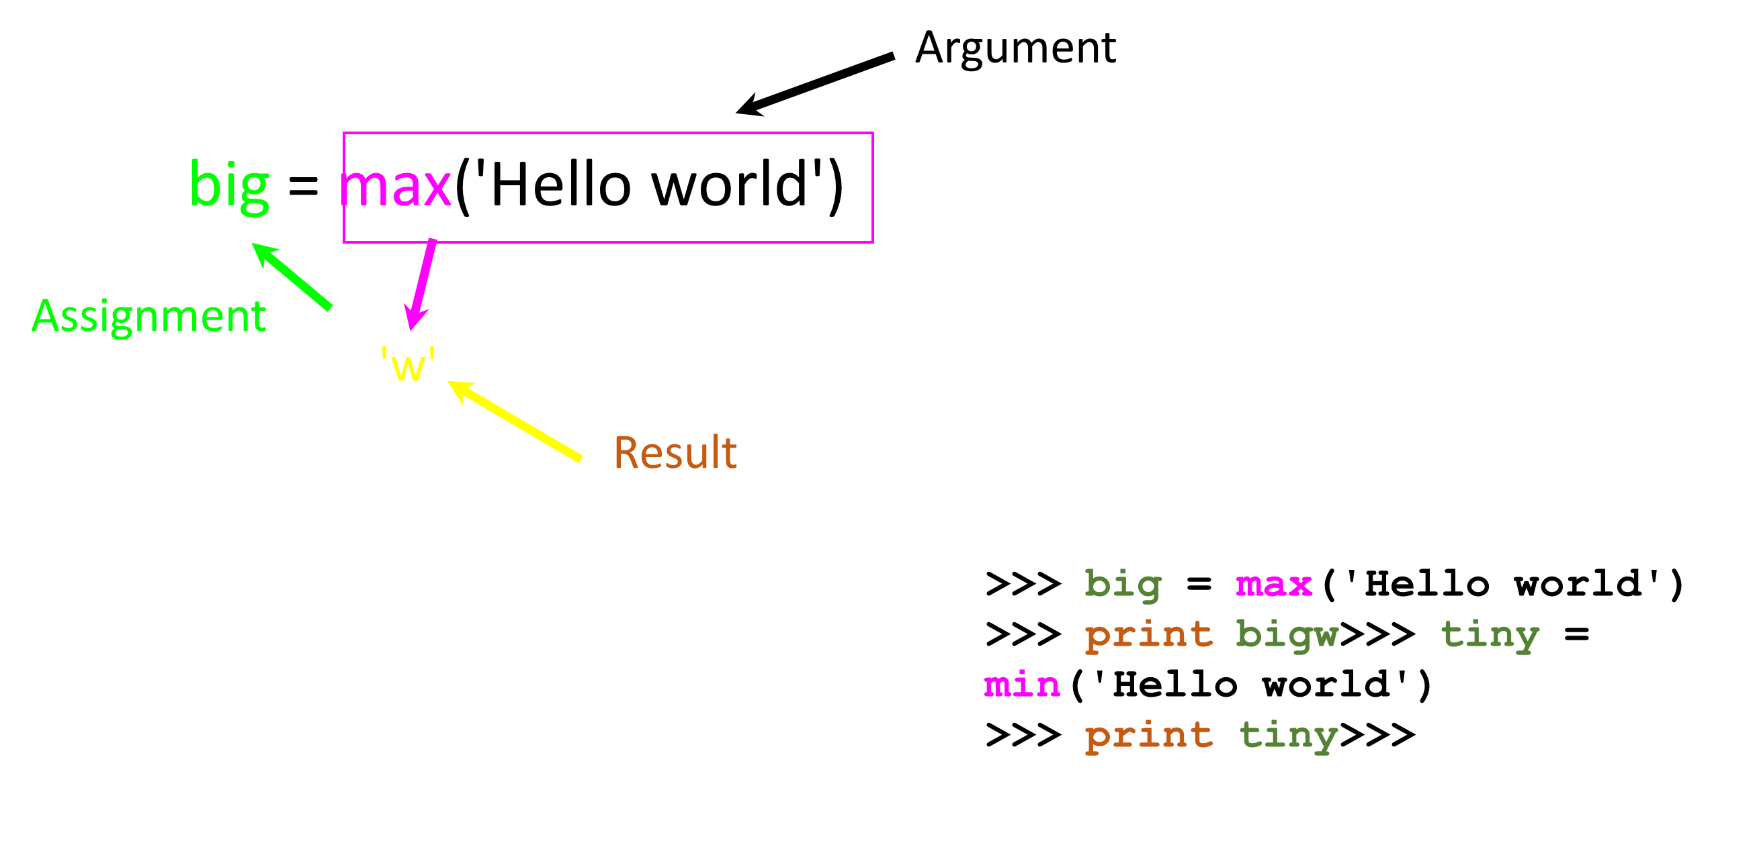
Understanding Regular Expressions

Slide 6
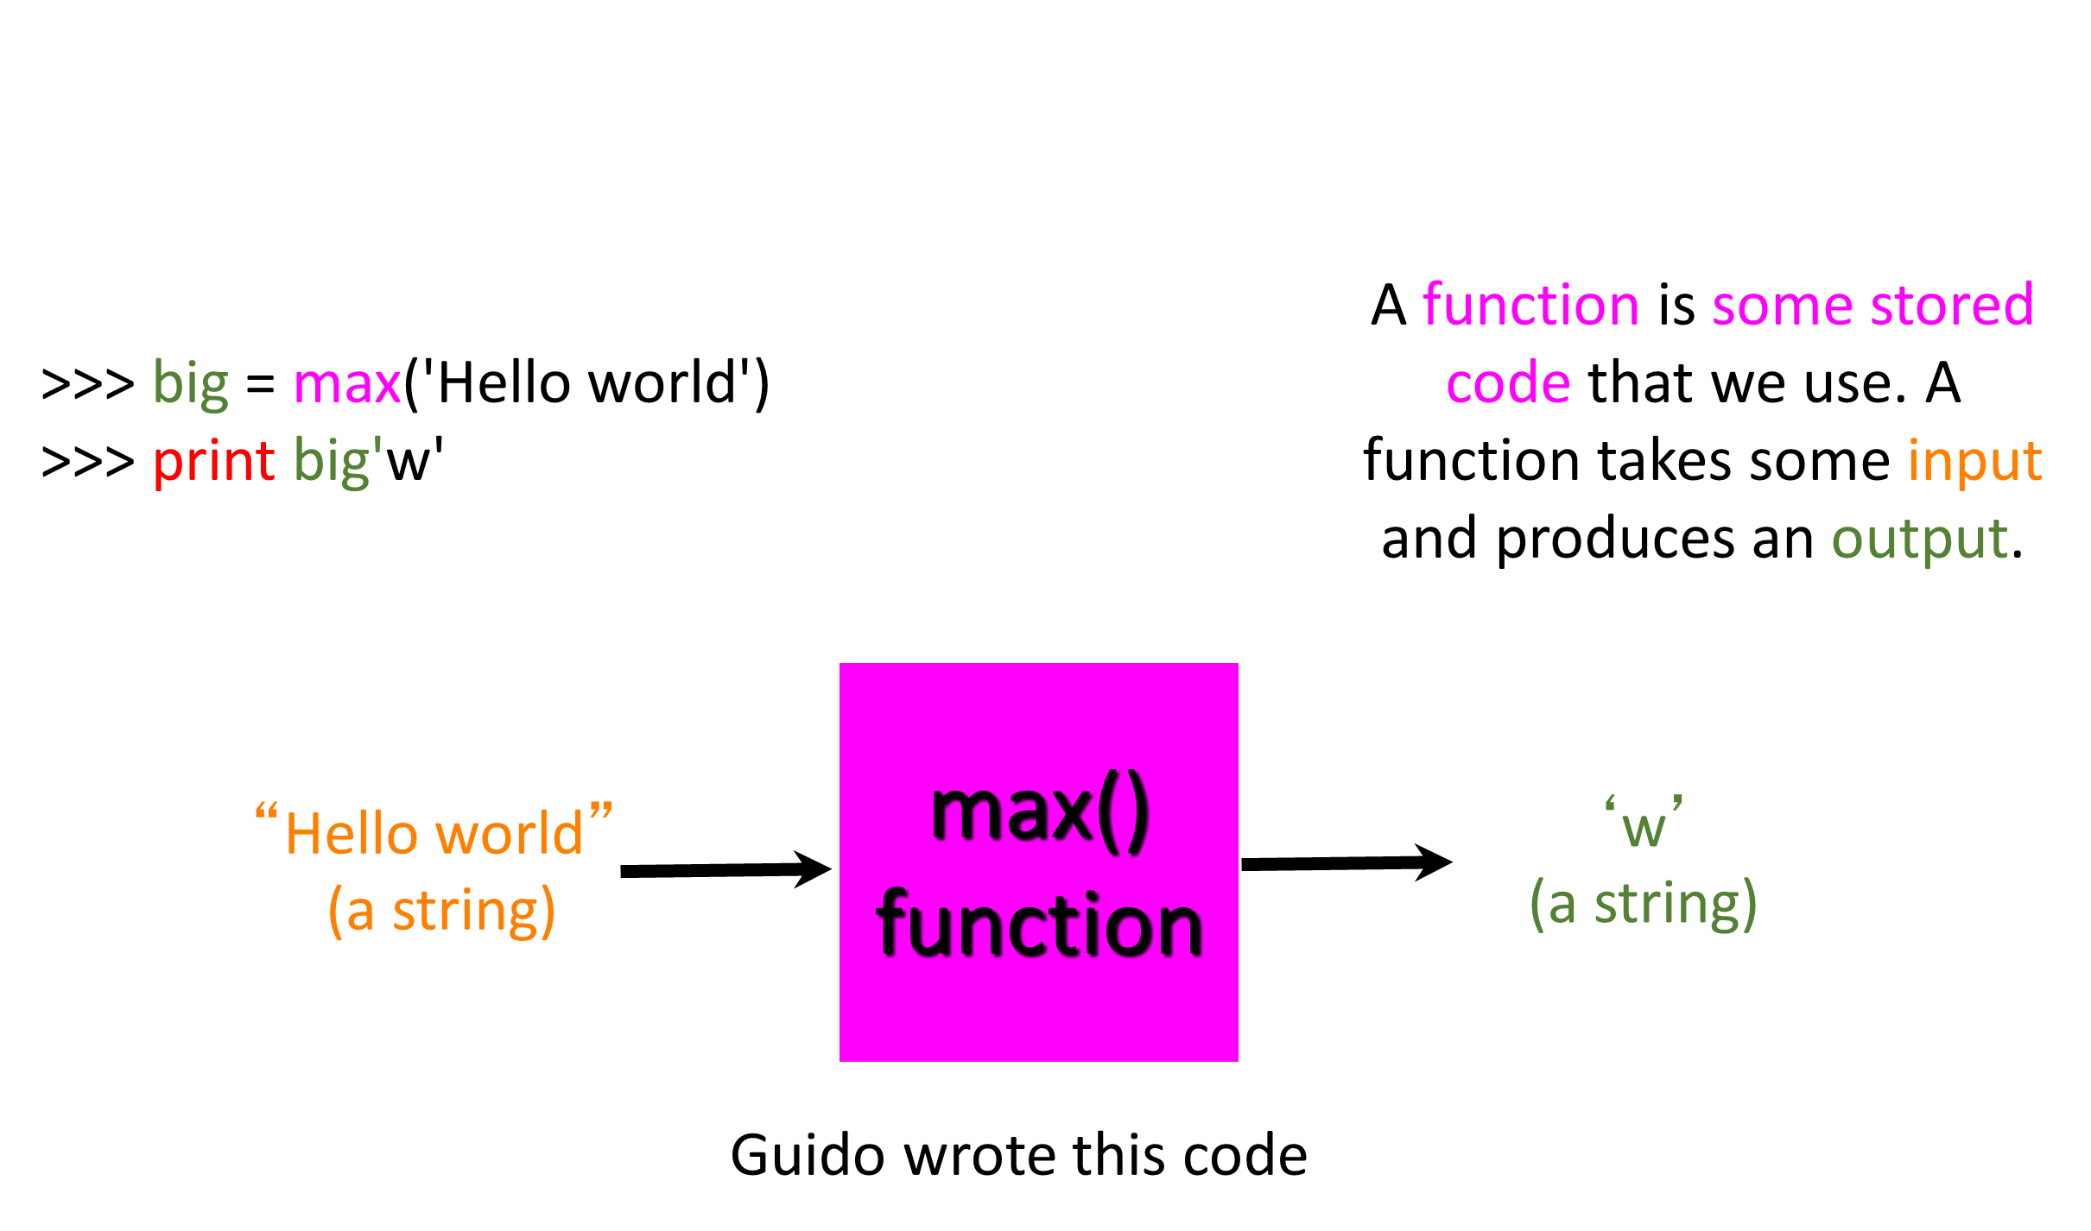
Max Function

Slide 7
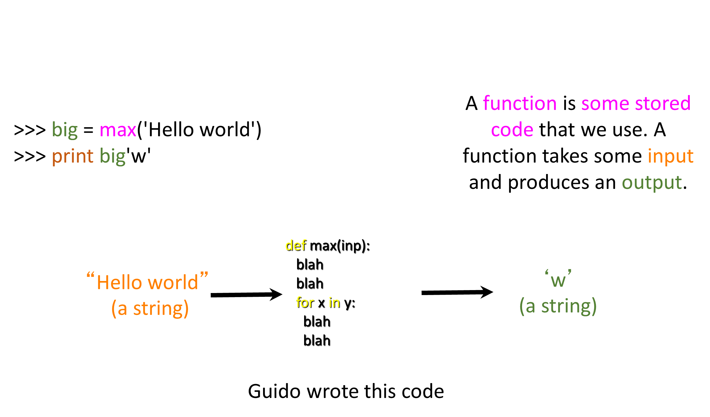
Max Function

Slide 8
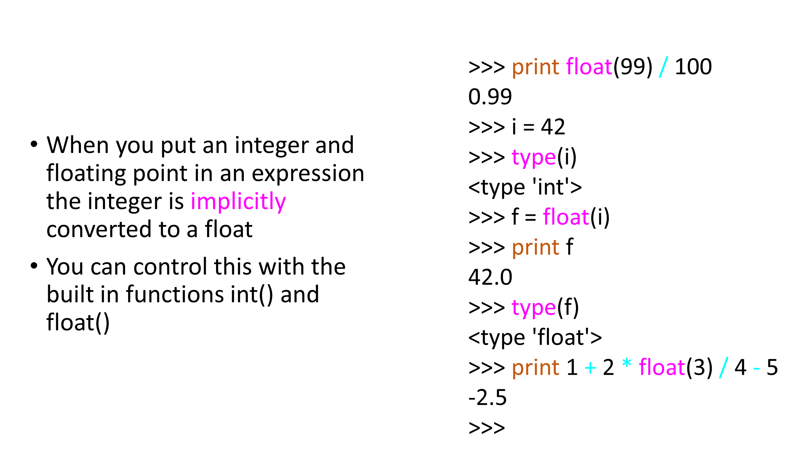
Type Conversions

Slide 9
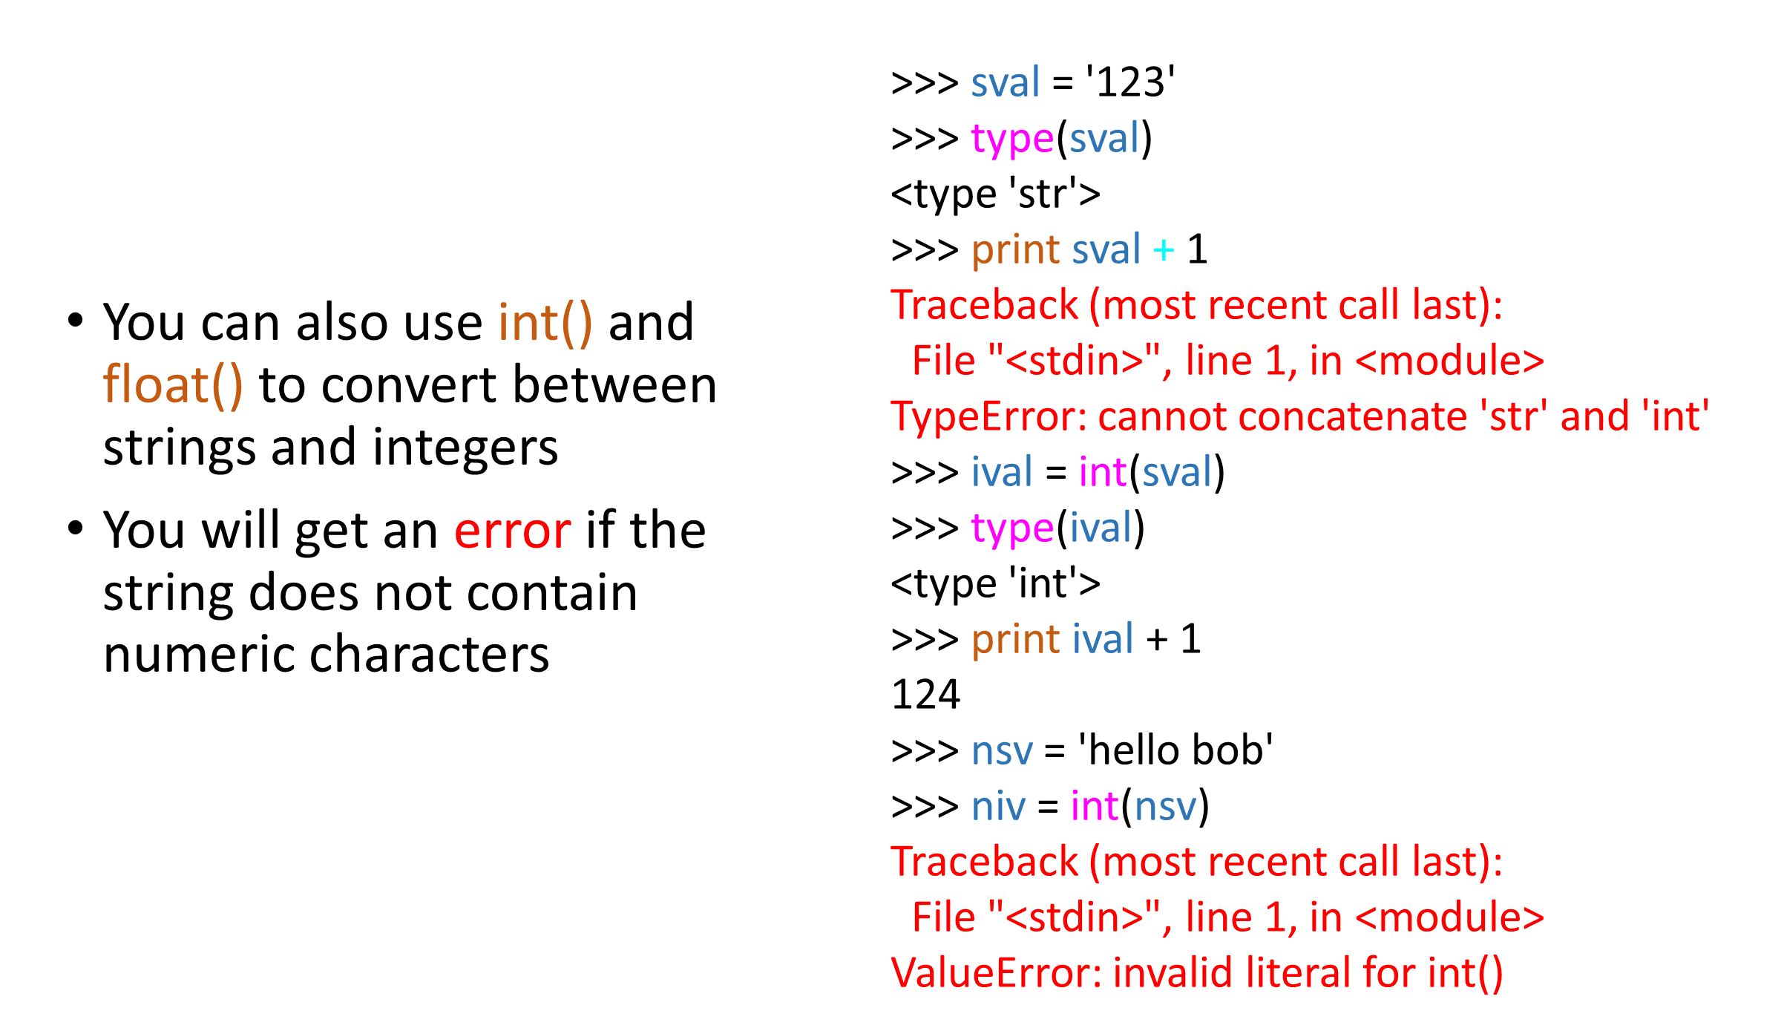
String Conversions

Slide 10
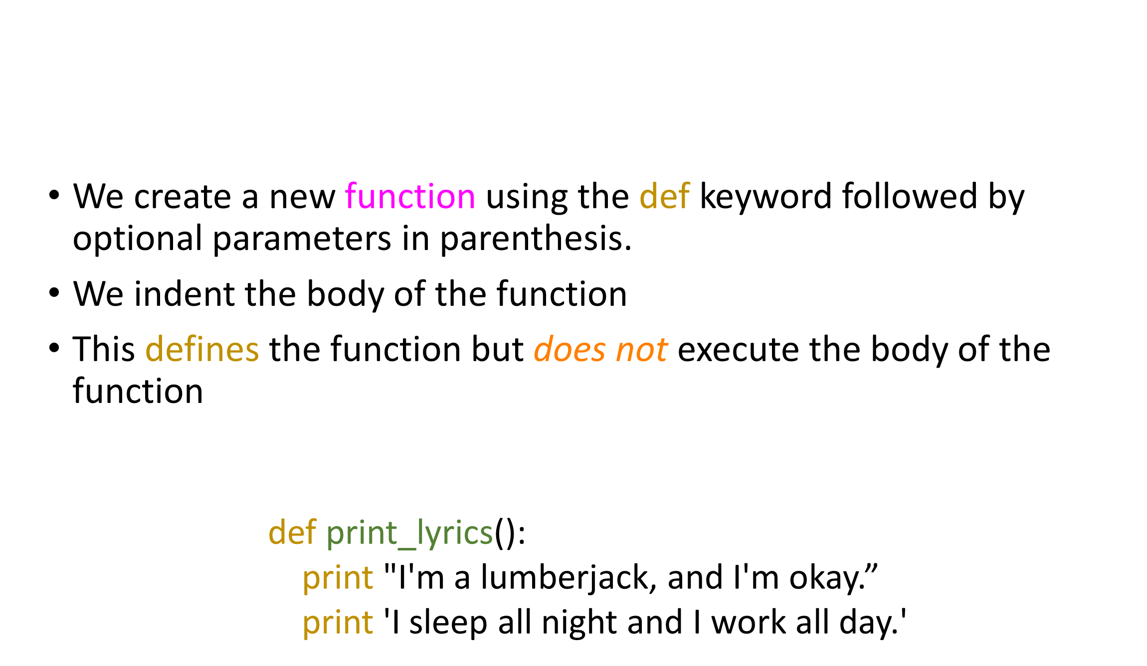
Building our Own Functions

Slide 11
Understanding Regular Expressions
x = 5
print('Hello')
def print_lyrics():
print("I'm a lumberjack, and I'm okay. ")
print('I sleep all night and I work all day. ')
print('Yo')
x = x + 2
print(x)

Slide 12
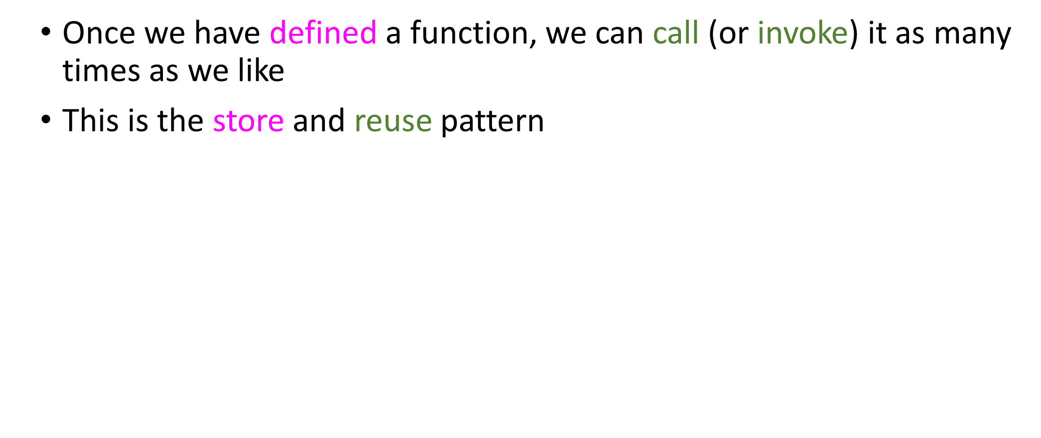
Definitions and Uses

Slide 13
Understanding Regular Expressions
x = 5
print('Hello')
def print_lyrics():
print("I'm a lumberjack, and I'm okay. ")
print('I sleep all night and I work all day. ')
print('Yo')
x = x + 2
print(x)
Hello
Yo
I'm a lumberjack, and I'm okay.I sleep all night and I work all day.
7

Slide 14
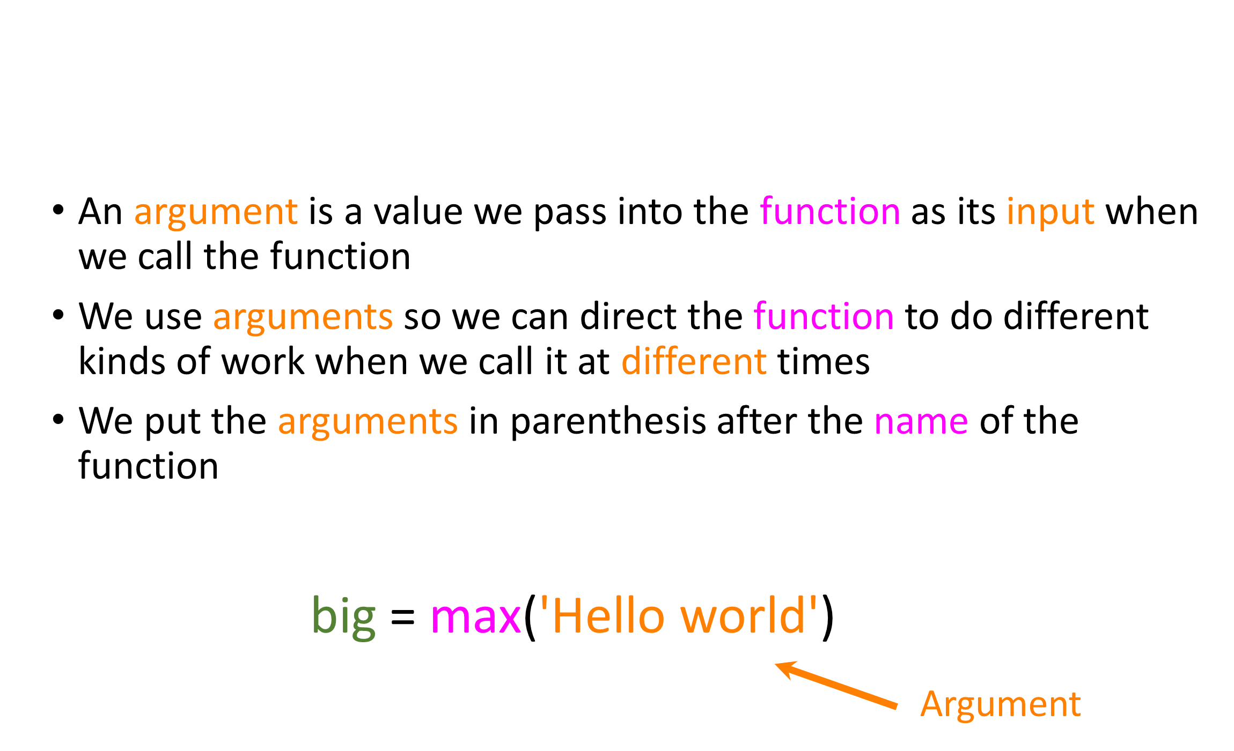
Arguments

Slide 15
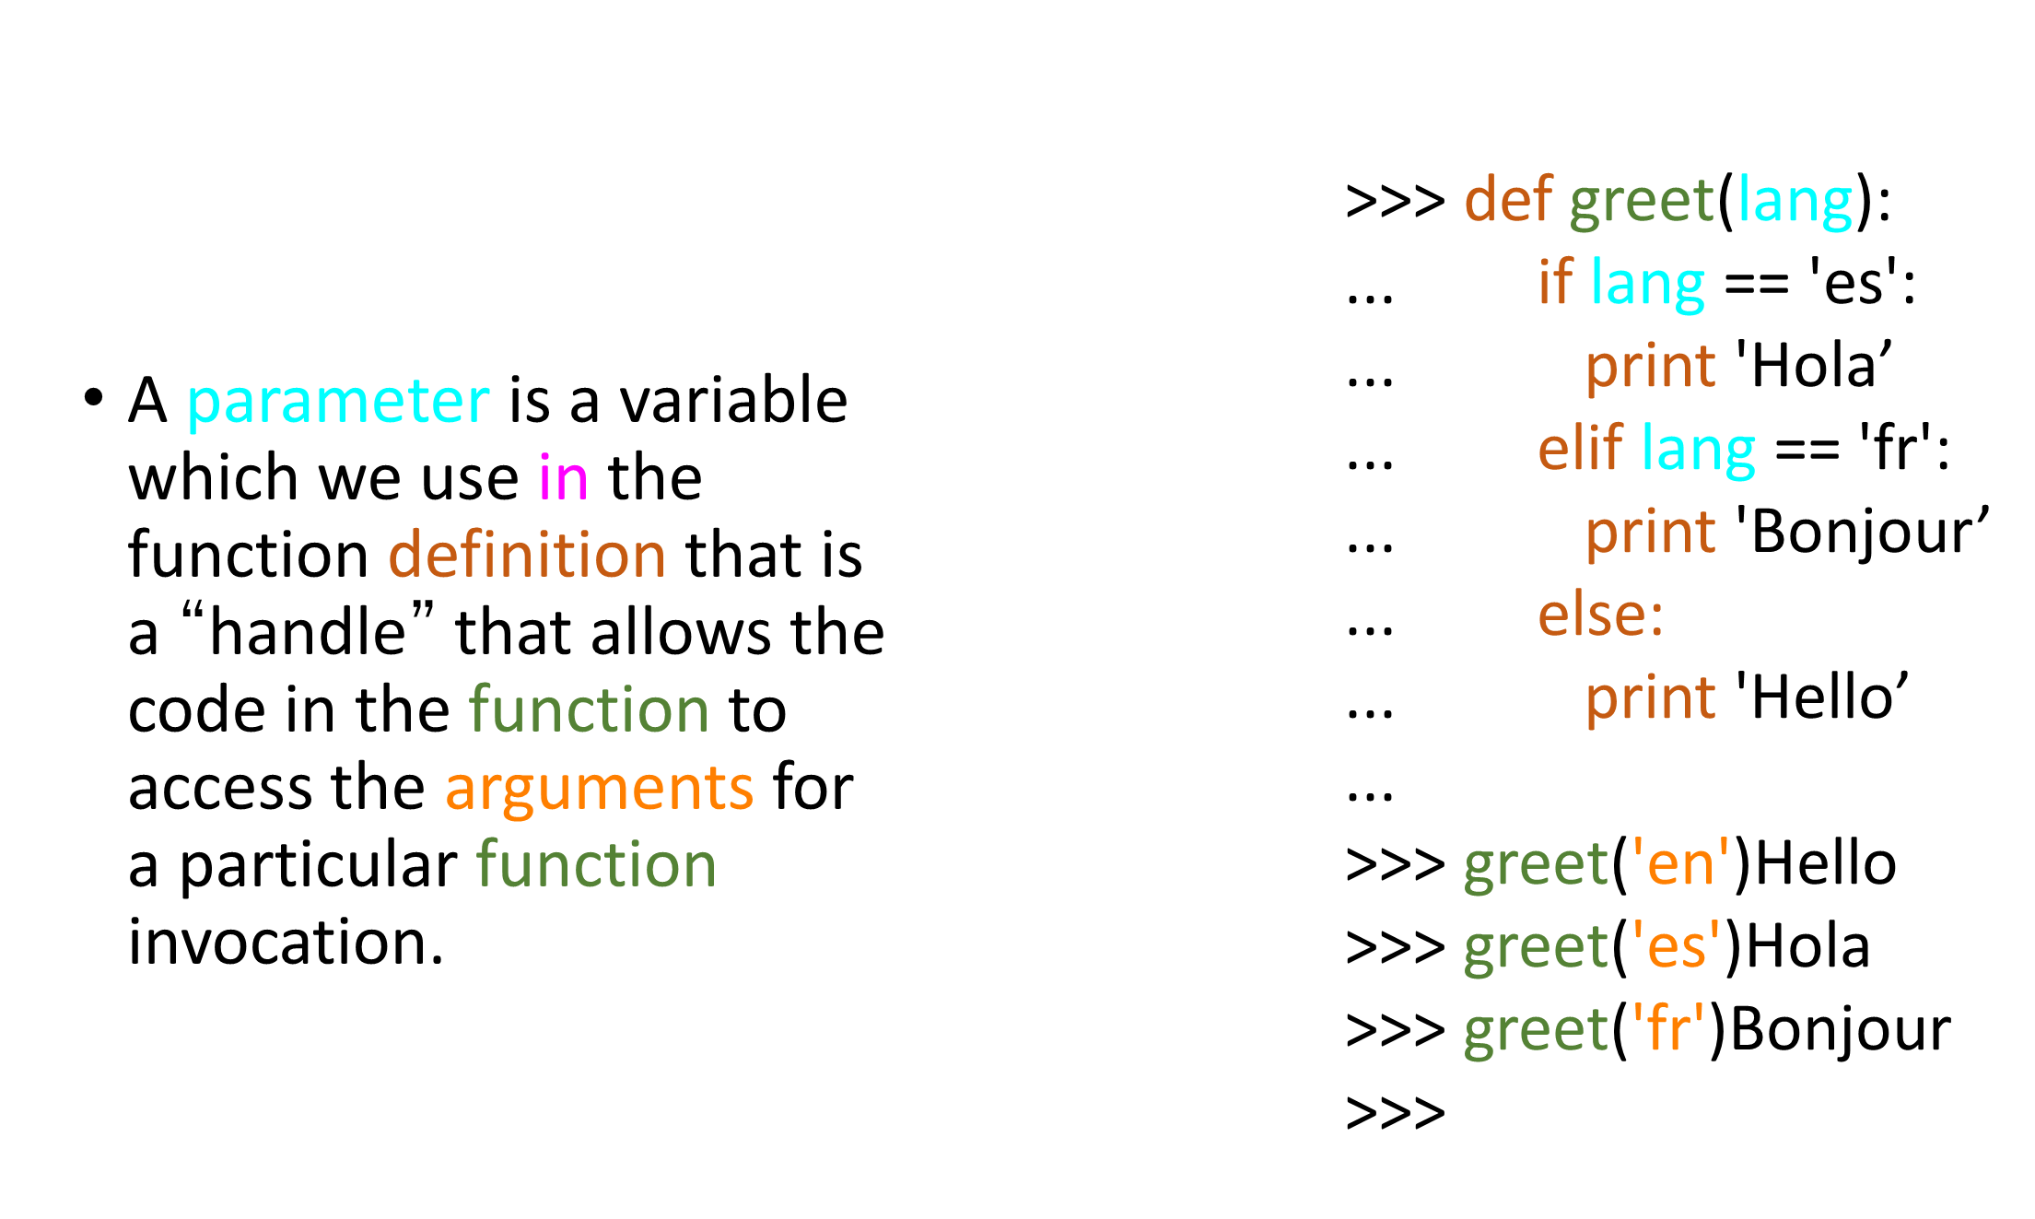
Parameters

Slide 16
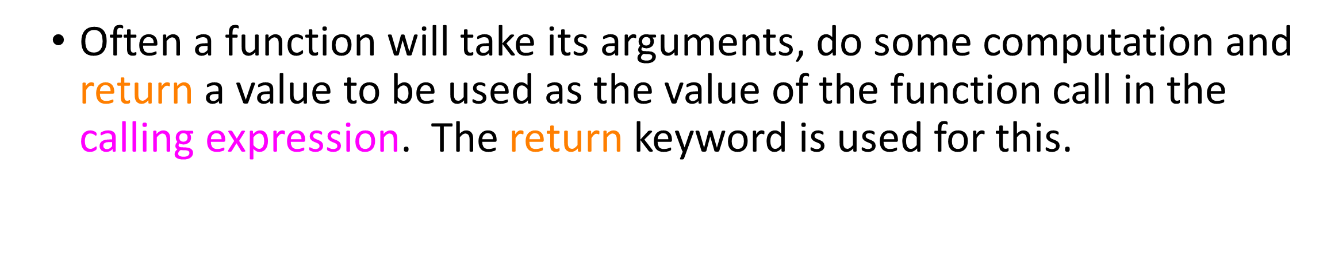
Return Values
def greet():
return "Hello”
print greet(), "Glenn”
print greet(), "Sally"

Slide 17
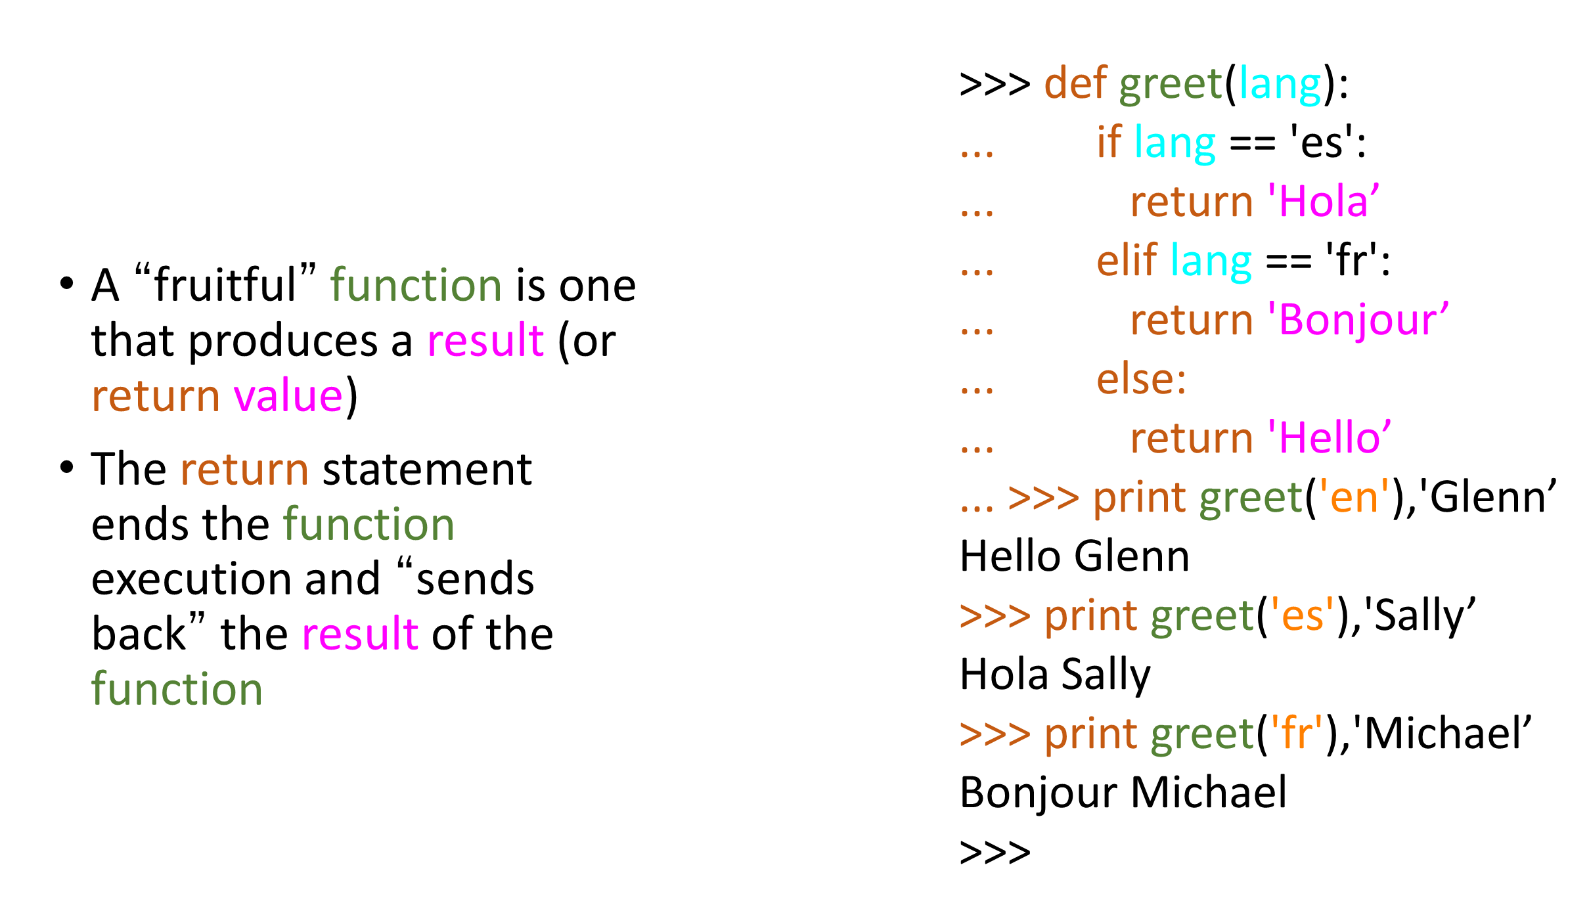
Return Value

Slide 18
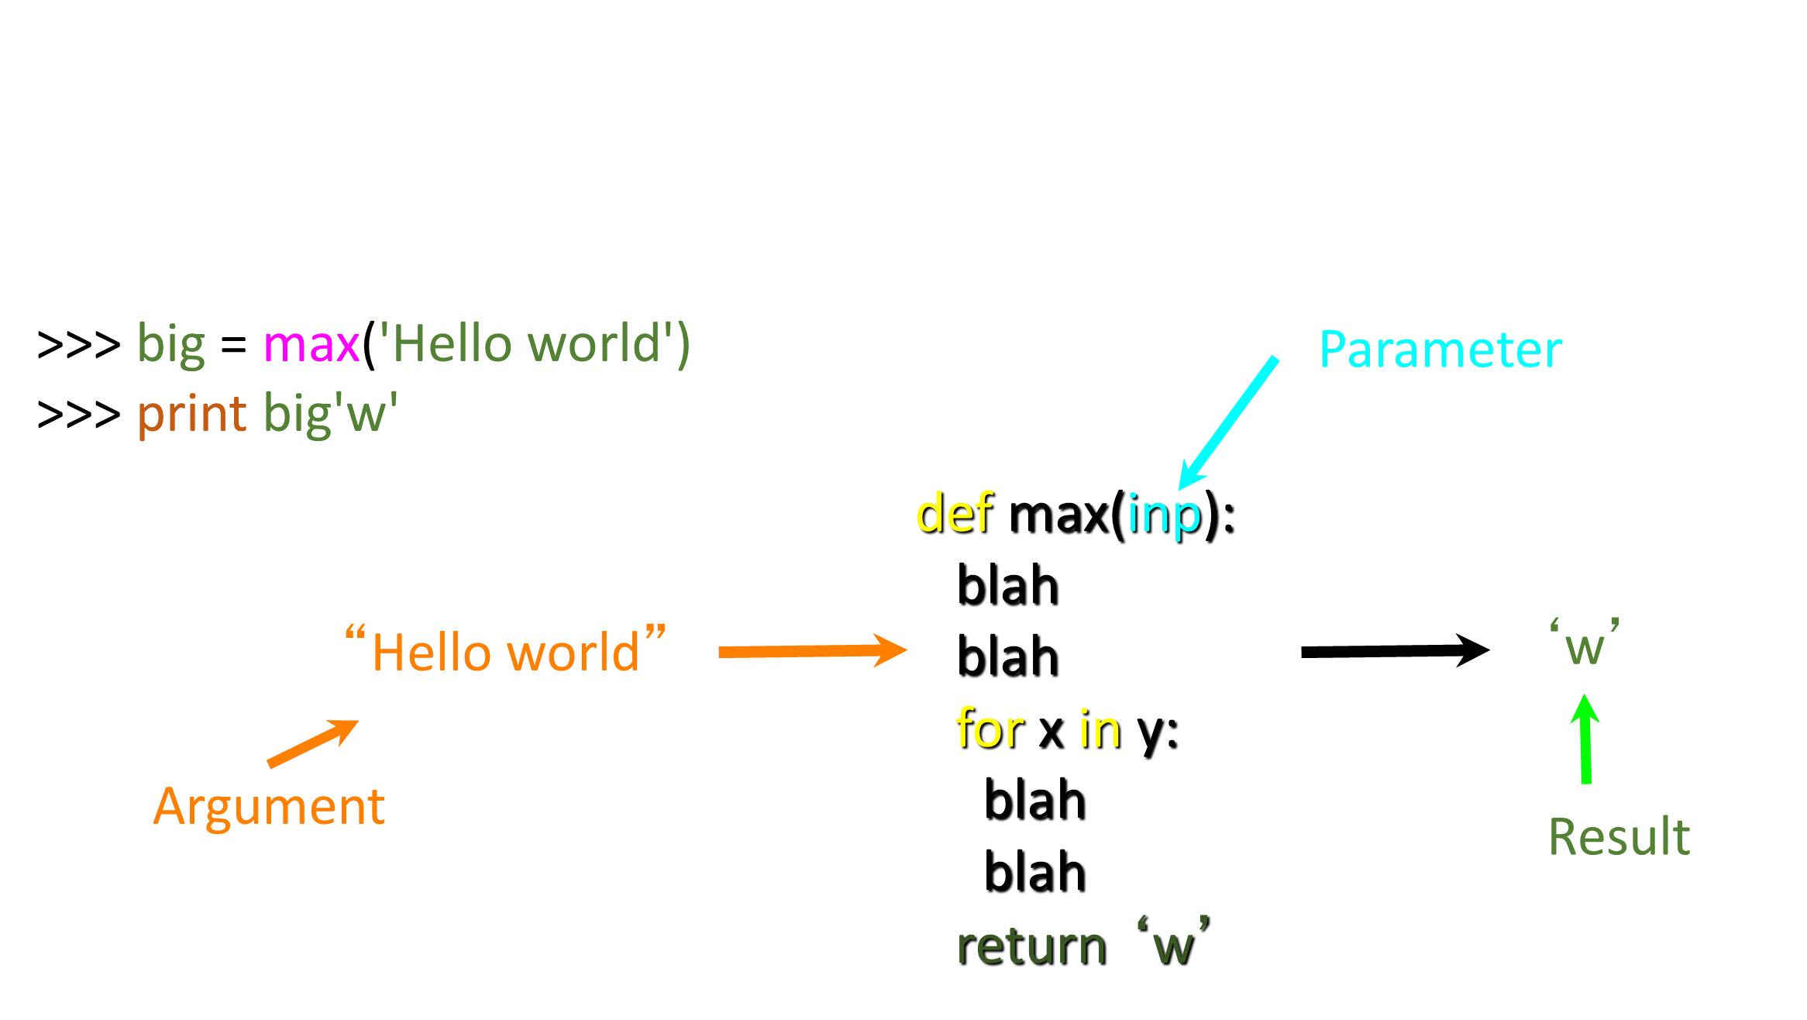
Arguments, Parameters, and Results

Slide 19
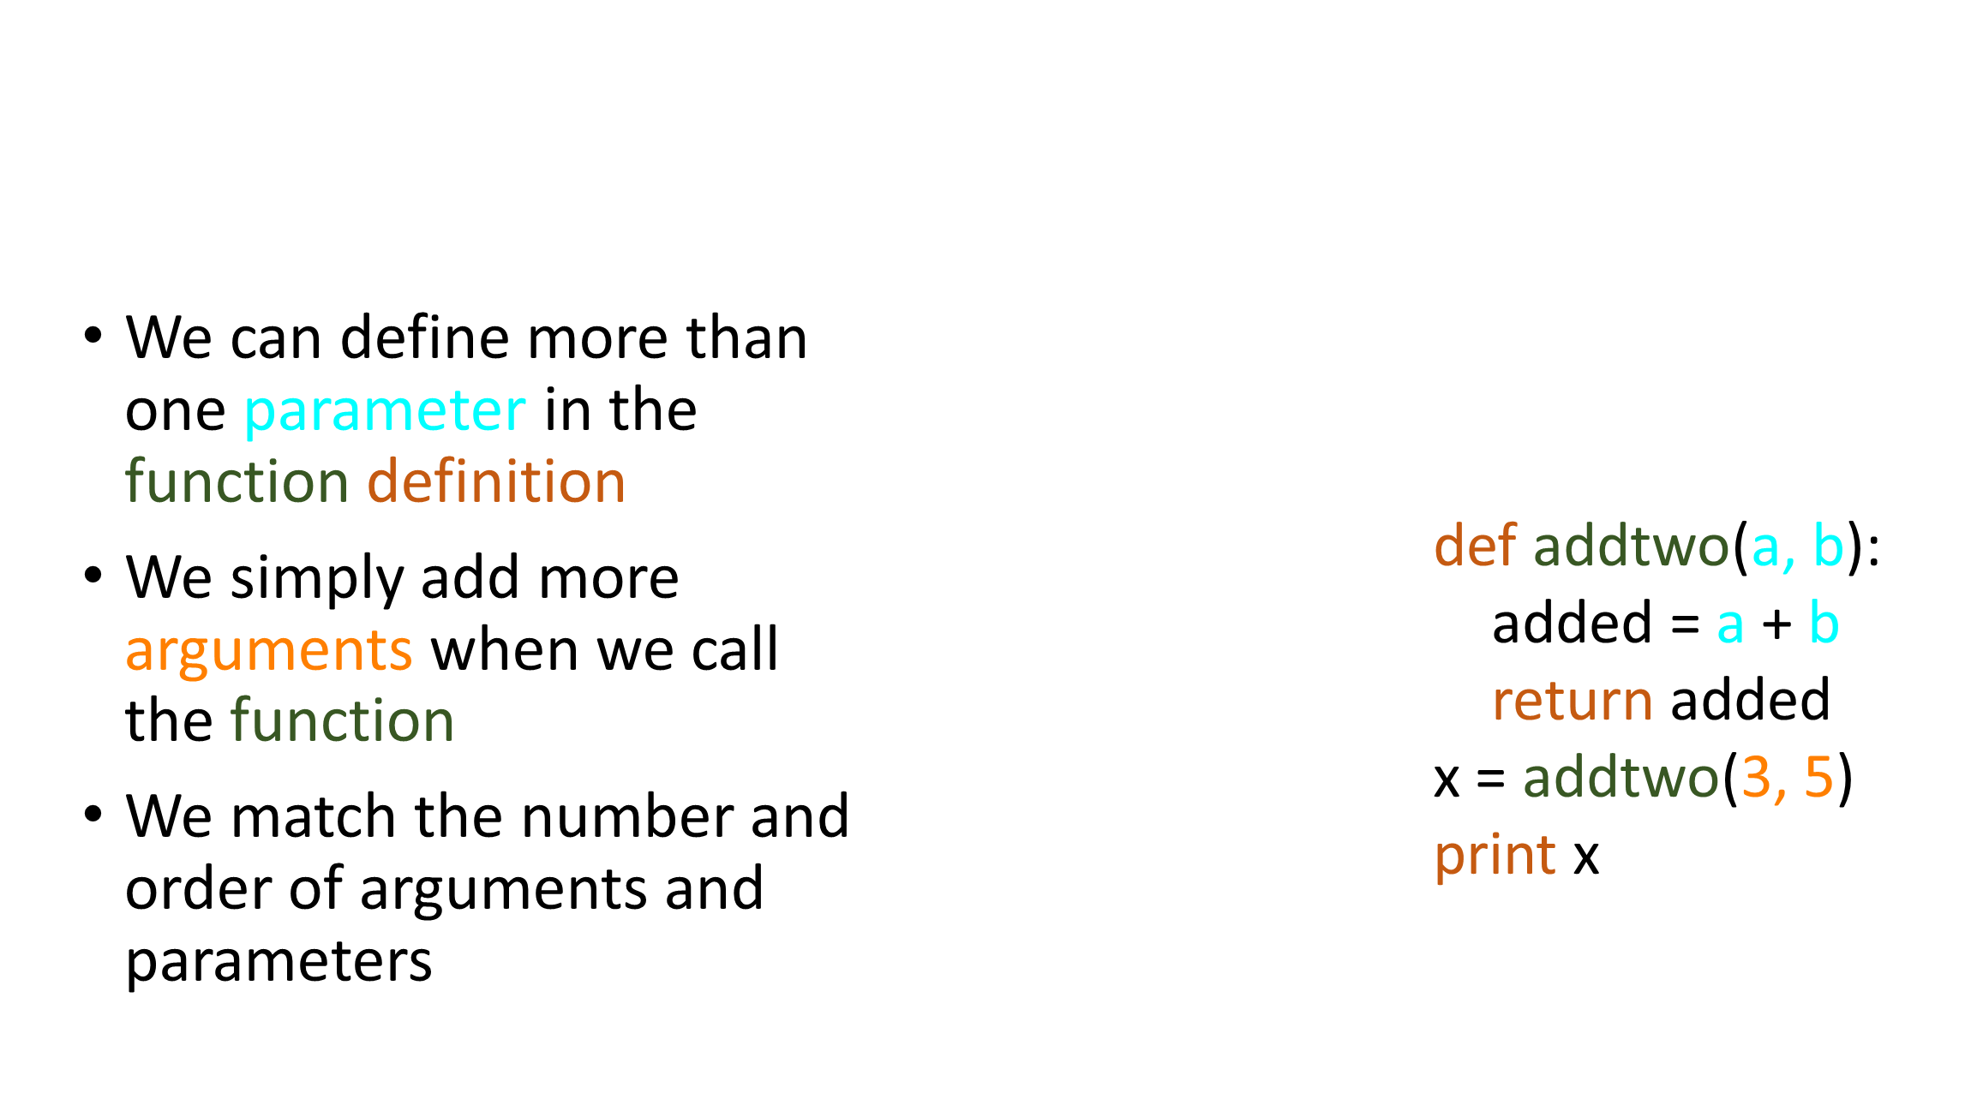
Multiple Parameters / Arguments

Slide 20
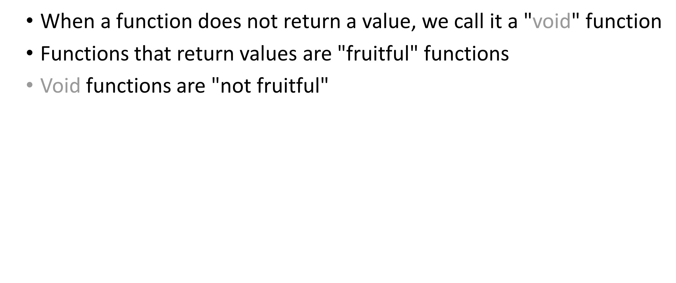
Void (non-fruitful) Functions

Slide 21
To function or not to function...
Organize your code into “paragraphs” - capture a complete thought and “name it”
Don’t repeat yourself - make it work once and then reuse it
If something gets too long or complex, break up logical chunks and put those chunks in functions
Make a library of common stuff that you do over and over - perhaps share this with your friends...

Slide 22
Exercise
Rewrite your pay computation with time-and-a-half for overtime and create a function called computepay which takes two parameters ( hours and rate).
Enter Hours: 45
Enter Rate: 10
Pay: 475.0
475 = 40 * 10 + 5 * 15

Slide 23
Summary
Functions
Built-In Functions
Type conversion (int, float)
Math functions (sin, sqrt)
Try / except (again)
Arguments
Parameters

Slide 24
Thank You

